Slide 1

Maharashtra Institute of Technology, Chh. Sambhajinagar
IPT Project Report
on
HOTEL MANAGEMENT SYSTEM
Presented by
Mr. Amar Ganesh Pawar
M.C.A (Second Year)
Under the Guidance of
Dr. Vaishali Bhagile
Year : 2023-24

Slide 2
Contents
Company Profile
Project Details
Project Introduction
Existing System and Need for System
Scope of work
Objective of Project
Software and Hardware Requirements
Technology Used
Proposed System
Analysis & Design
Table Design
Menu Tree Diagram
Menu Screen
Test Cases
Proposed Enhancements
Drawbacks and Limitations
Conclusion
References

Slide 3
Company Profile
Company Name : Perfect Software Solution
Address : Shreya Nagar, Usmanpura, Chh.Sambhainagar
Website : www.perfectsoftwaresolution.com
Company Guide Details :
Name : Uday.C.Chaatupale
Email : uday_chaatupale@PerfectSoftwareSolution
Mobile No : 9422291397

Slide 4
Project Details
Project Title : Hotel Management System
Technology : .Net ,C#
Database : SQL Server Management
Software : Visual Studio 2022

Slide 5
Project Introduction
Hotel management project provides room booking, staff management and other necessary hotel management features.
The system allows the manager to post available rooms in the system. Customers can view and book room online.
Who can use the system :
In this Hotel Management System there are three types of user
1) Admin
2) Owner of hotel
3) Staff

Slide 6
Existing System and Need for System
Existing System:
To overcome the drawbacks of existing system, this project is proposing a smarter way of communication.
As discussed earlier an automated notification system can be developed using a very popular web based platform which will provide a Desktop based application.

Slide 7
Need of System:-
Streamlined Operations:-
A hotel management system automates and integrates various operational tasks such as reservations, check-ins and check-outs, room assignments, housekeeping schedules, inventory management, billing, and reporting.
Resource Management:-
Efficient allocation of resources such as rooms, staff, and amenities is critical for maximizing profitability.

Slide 8
Scope of work
A hotel management system helps in enhancing the guest experience by providing them with hasle-free check-in and check- out process.
It allows guests to easily book rooms online and access real-time information about room availability, pricing, and services offered.

Slide 9
Objective of Project
A hotel management system helps in enhancing the guest experience by providing them with a hassle-free check-in and check-out process.
It allows guests to easily book rooms online and access real-time information about room availability, pricing, and services offered.

Slide 10
Software and Hardware Requirements
Server Side Software Requirements:
Operating System: Windows 10.
Development Environment: Visual Studio with .NET Framework or .NET Core SDK.
Database Management System: SQL Server or alternative like MySQL.
Server Side Hardware Requirements:
Processor: Multi-core processor (e.g., Intel Core i5 or equivalent AMD).
Memory (RAM): Minimum 8GB RAM.
Storage: SSD Storage recommended.
Display: Monitor with 1920x1080 resolution or higher.

Slide 11
Client Side Hardware Requirements
Processor:- Dual-Core 1.6 Ghz or higher
Processor speed:- 250MHz to 833 MHz
RAM:- 2GB
Hardware Disk:- 500 MB free disk space
Other:- Network card is required.
Client Side Software Requirements
Operating System:- Windows 10 or later.
Development Environment:- Visual Studio with .NET Framework or .NET Core SDK.
Database Management System:- SQL Server or alternative like MySQL or Postgre SQL.
Web Server:- Internet Information Services (IIS).

Slide 12
Technology Used
Front end:
C#:Microsoft introduced C# along with .NET Framework and Visual Studio, both of which were closed-source.
.NET: .NET is an open-source, server-side web-application framework designed for web development to produce dynamic web pages.
Back end:
SQL Server: Structured Query Language (SQL)is a domain-specific language used in programming and designed for managing data held in a relational database management system (RDBMS), or for stream processing in relational data stream management system (RDSMS).

Slide 13
Proposed System
Proposed System:-
Administrator Interface Design.
Security Authentication.
Reports.
General end-users.
The following are the modules included in this system:-
Admin
Owner
Employee
Staff

Slide 14
Analysis & Design Data Flow Diagram
Hotel Administrator
Customers Information
Customer
Information
Customer
Hotel Management System
Job Department
Bill Information
Employee
List of Customers

Slide 15
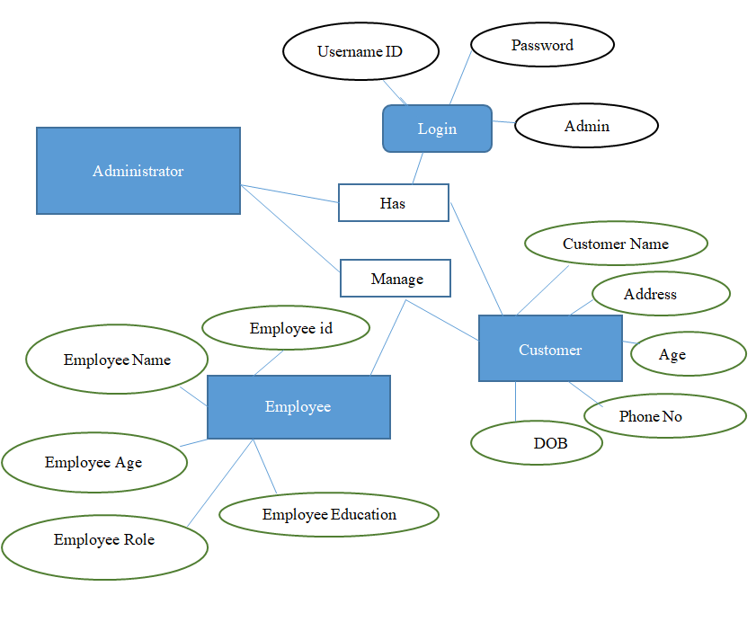
Entity Relationship Diagram

Slide 16
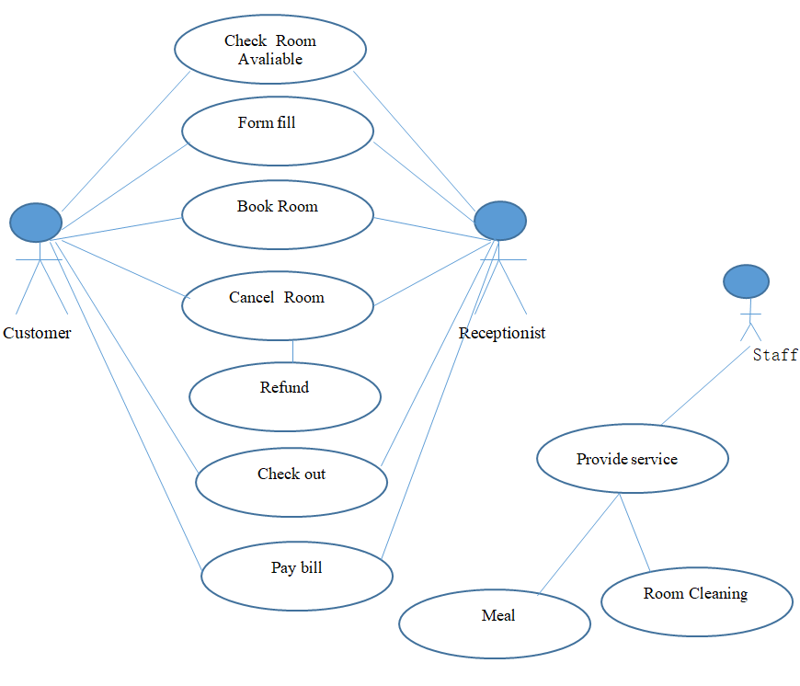
UML Diagram(Use Case Diagram)

Slide 17
Table Design
Table Name : User Table
Name | Data Type | Allow Nulls | Default
User ID | int | Not Null | True
User Name | Varchar(20) | Null | False
password | Varchar(30) | Null | False
User role | int | Null | False
Table Name : Countries
Name | Data Type | Allow Nulls
CountryID | int | Not Null
CountryName | Nvarchar(100) | Null
IsDeleted | bit | Null

Slide 18
Table Name : State
Name | Data Type | Allow Nulls
StateID | int | Not Null
StateName | Nvarchar(100) | Null
IsDeleted | bit | Null
Table Name : District
Name | Data Type | Allow Nulls
DistrictID | int | Not Null
DistrictName | Nvarchar(100) | Null
IsDeleted | bit | Null

Slide 19
Table Name : City
Name | Data Type | Allow Nulls
CityID | int | Not Null
CityName | Nvarchar(100) | Null
DistrictName | Nvarchar(100) | Null
StateName | Nvarchar(100) | Null
CountryName | Nvarchar(100) | Null
IsDeleted | bit | Null
Table Name : Designation
Name | Data Type | Allow Nulls
DesignationID | int | Not Null
DesignationName | Nvarchar(100) | Null
IsDeleted | bit | Null

Slide 20
Table Name : Customer
Table Name : Employee
Name | Data Type | Allow Nulls
CustomerID | int | Not Null
CustomerName | Nvarchar(100) | Null
Address | Nvarchar(100) | Null
WhatsappNo | bigint | Not Null
GstNo | bigint | Not Null
Name | Data Type | Allow Nulls
EmployeeID | int | Not Null
EmployeeName | Nvarchar(100) | Null
Address | Nvarchar(100) | Null
Education | Nvarchar(100) | Null
DesignationName | Nvarchar(100) | Null

Slide 21
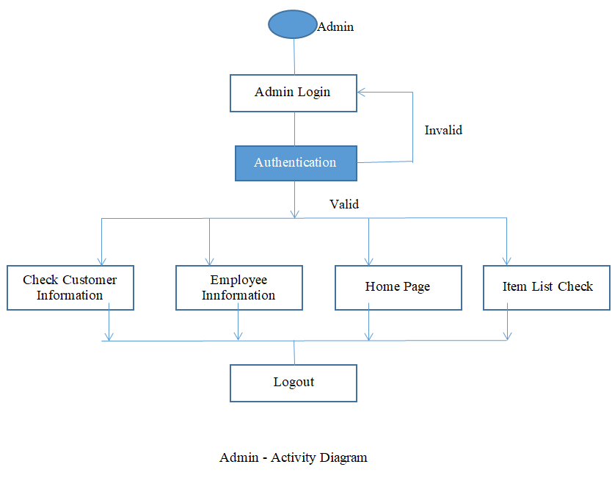
Menu Tree Diagram
Admin

Slide 22
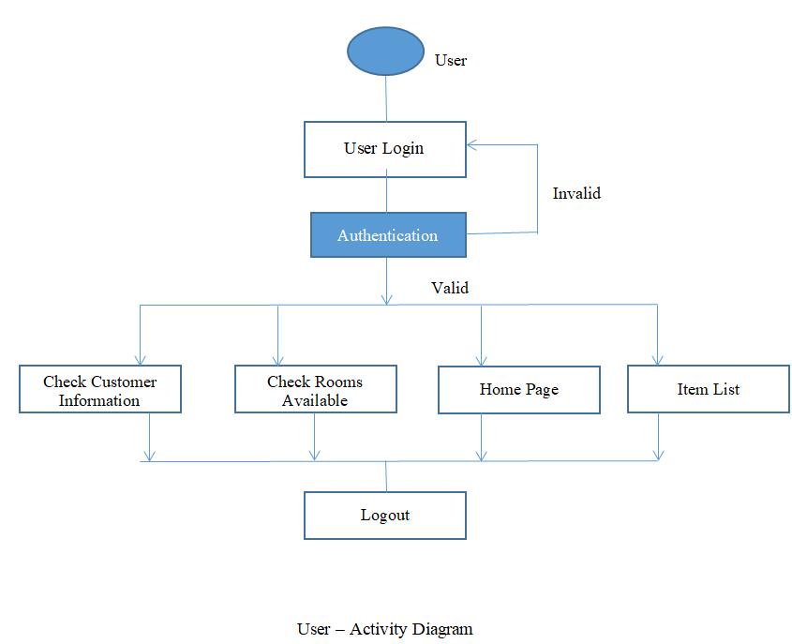

Slide 23
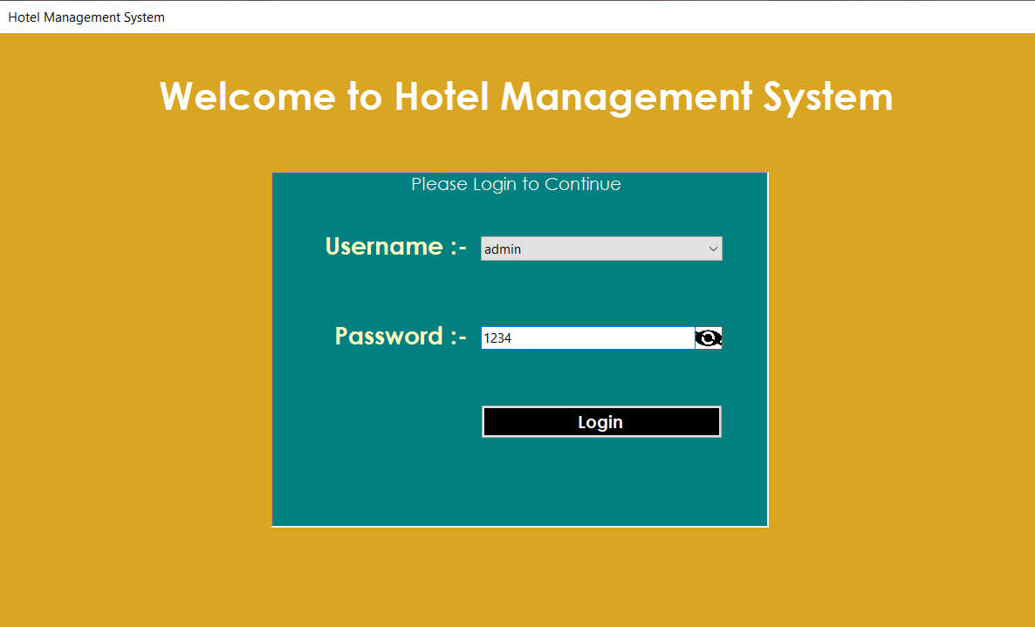
Menu Screen

Slide 24
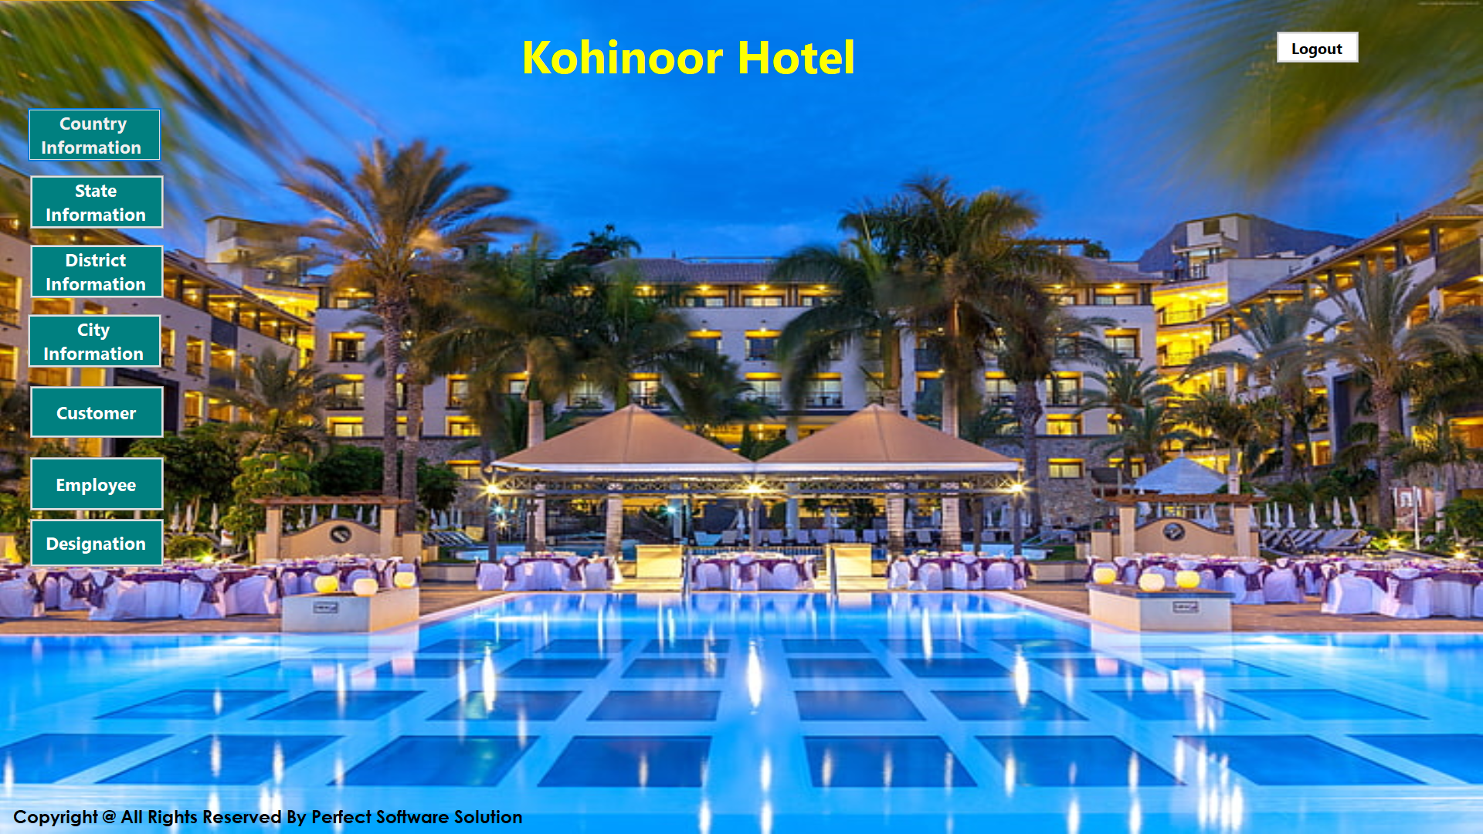

Slide 25
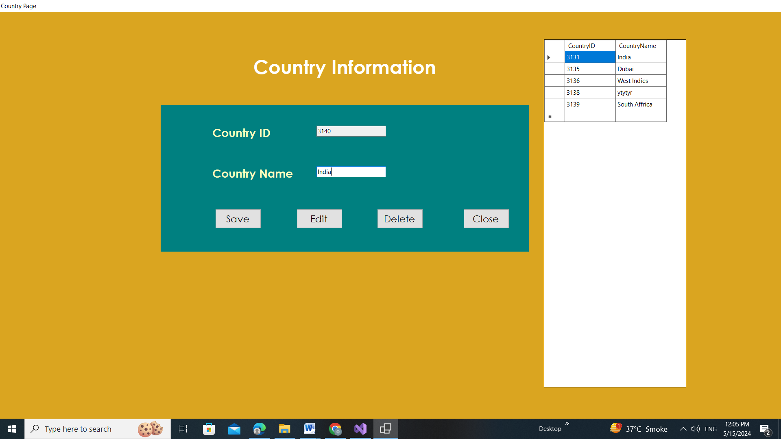

Slide 26
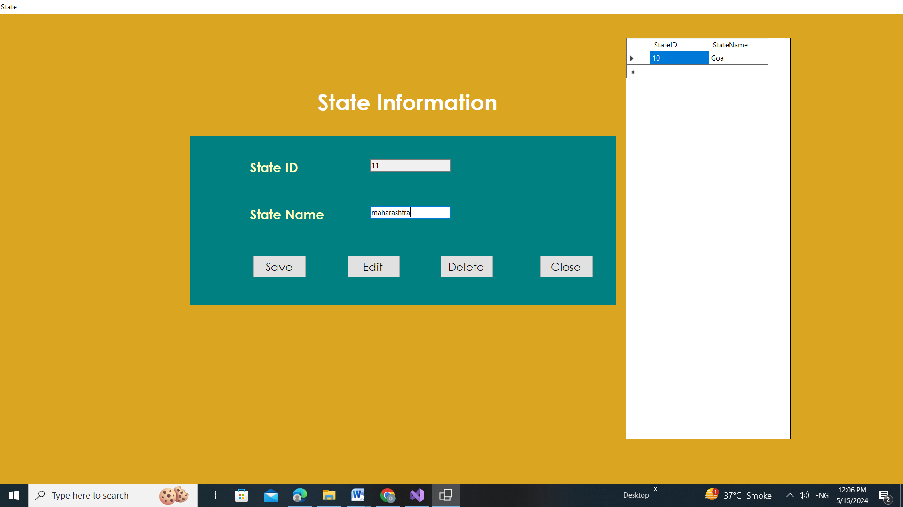

Slide 27
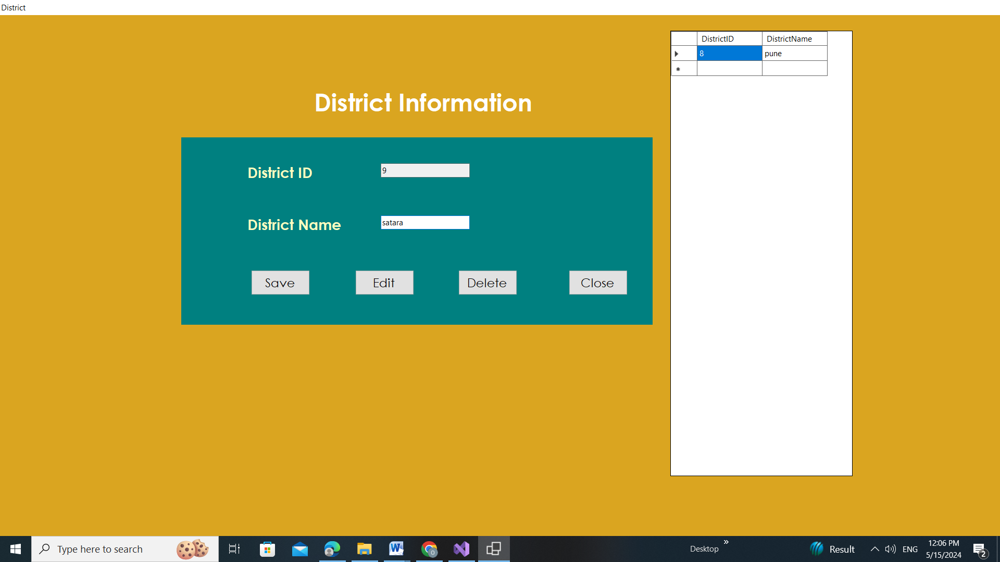

Slide 28
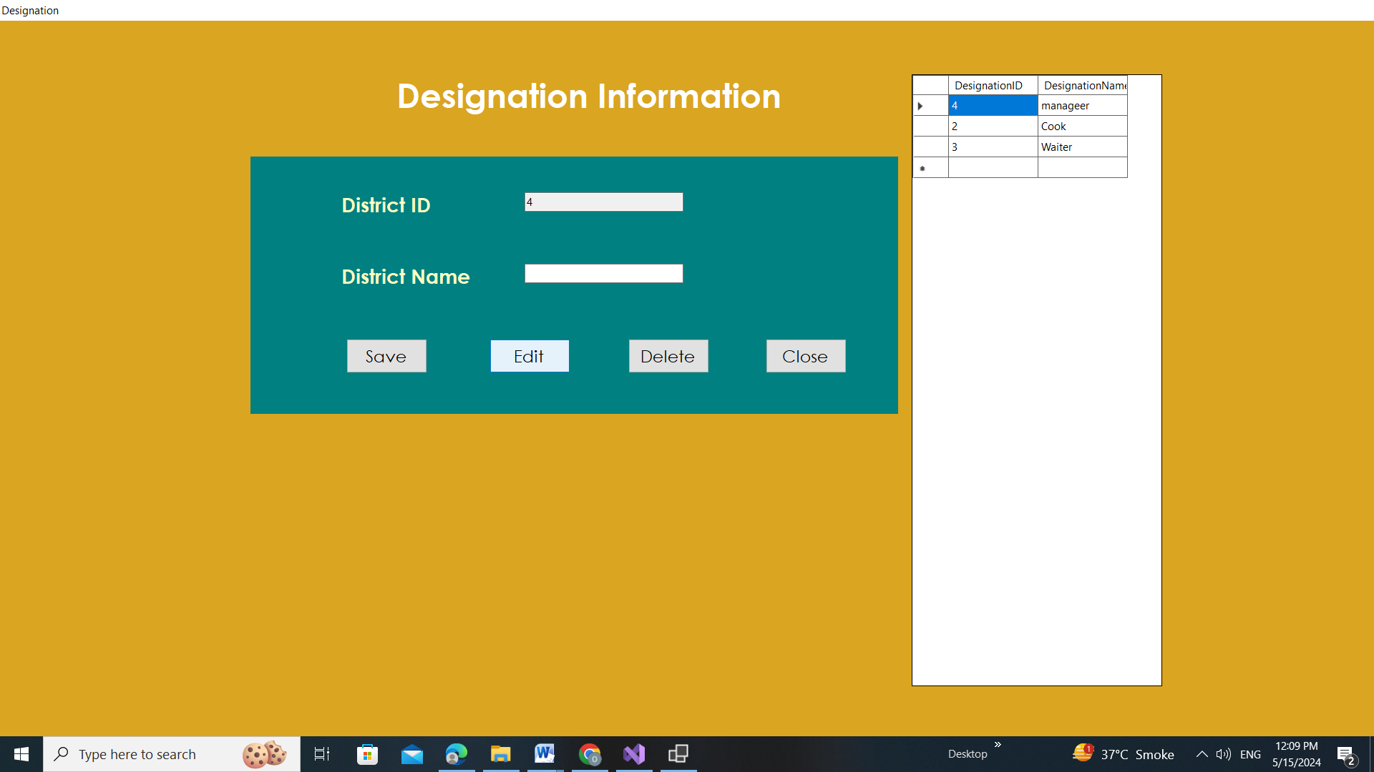

Slide 29
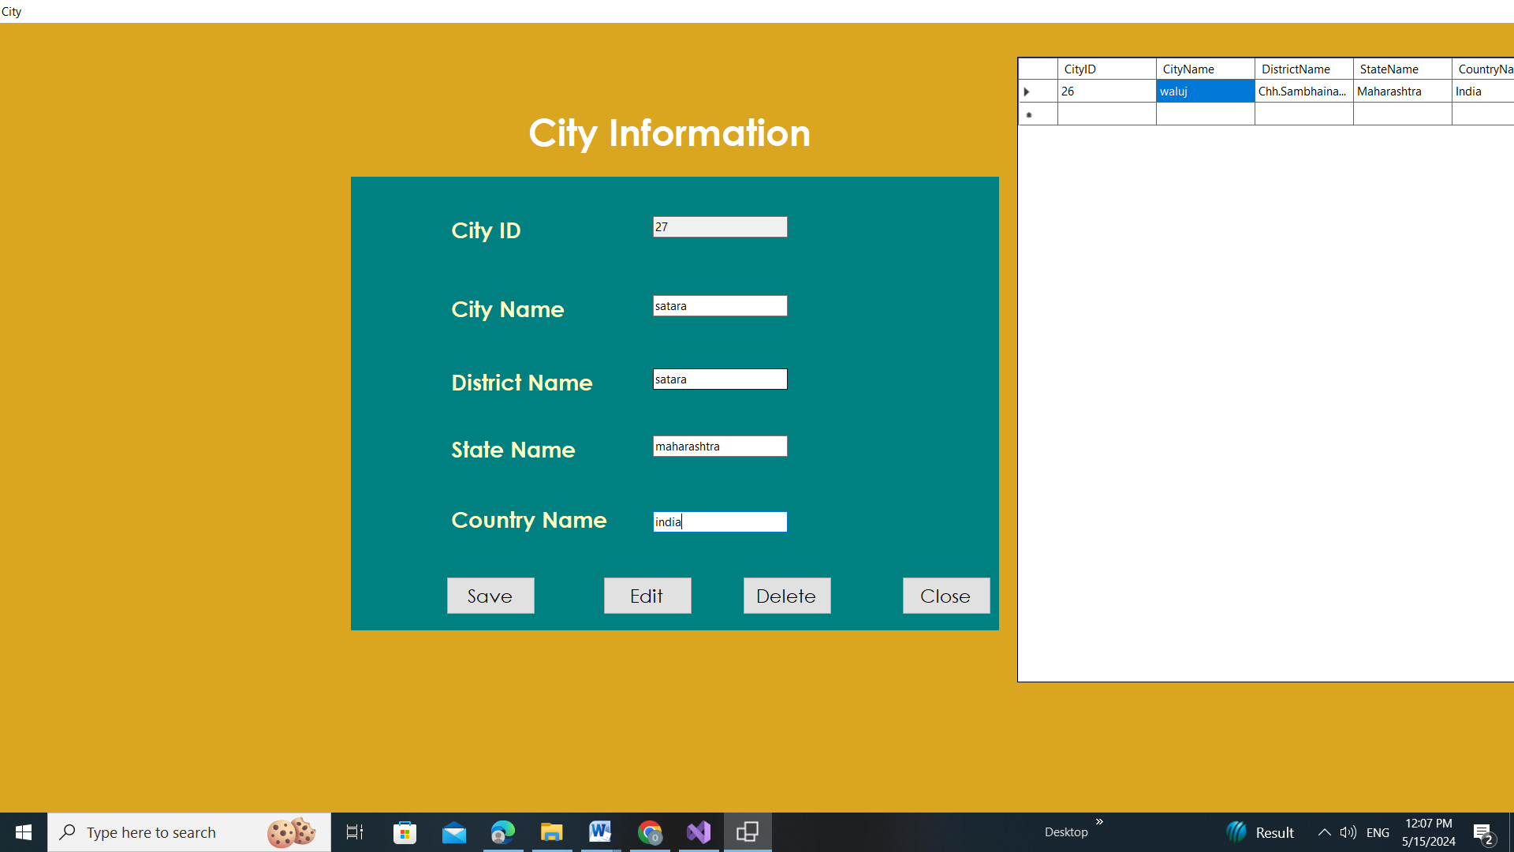

Slide 30
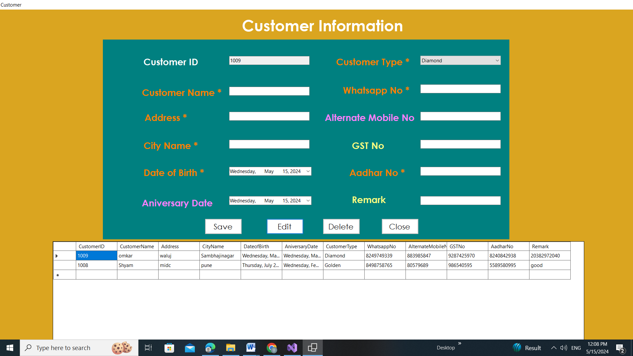

Slide 31
Test Cases
Testing For Login Page
Test Engineer: | Group members
Test Case ID: | TC1
Date: | 13-4-2024
Purpose: | For valid outcome, and restriction to fill every form (Login, Signup,)
Pre-Req: | The customer will first of all enter his credentials in order to get himself registered with the system.
Test Data: | Foam consisting of different variables and data are tested in this test case. A member cannot leave a field empty.
Steps: | Steps to carry out the test. See step formatting rules below. Visit the Hotel Management System official website. Enter Username ( Required ) Enter Password ( Required ) Submit
Status: | Pass

Slide 32
Testing for Menu Page
Test Engineer: | Group members
Test Case ID: | TC1
Date: | 10-5-2024
Purpose: | To check everything is in order because Admin has all authority.
Pre-Req: | First, an Admin must be logged in to the system. (Required)
Test Data: | All data and variables related to the admin panel are used in this testing. The Following major components · Add Items · Check Rooms · Customer Information · Employee Information
Steps: | Login, (required). Admin will add Items Admin will check All Customer Information Admin will check all available Rooms Admin will maintain Software Submit
Status: | Pass

Slide 33
Proposed Enhancements
Here are some proposed enhancements for Hotel Management Systems (HMS) to address current drawbacks and limitations:
Scalable Solutions: Develop tiered pricing structures and cloud-based options to make HMS more affordable for smaller hotels.
Offline Functionality: Implement features that allow basic operations to continue during internet outages, minimizing disruptions.
Enhanced Security: Integrate advanced cyber security measures including encryption, multi-factor authentication, and regular security audits.

Slide 34
Drawbacks and Limitations
Hotel management systems (HMS), while powerful tools, do come with some drawbacks and limitations.
Cost: Implementing and maintaining an HMS can be expensive, especially for smaller hotels. Subscription fees, training costs, and potential hardware upgrades can add up.
Dependence on Technology: HMS relies heavily on a stable internet connection. Any outages can disrupt operations, leading to frustrated guests and potential revenue loss.
Security Risks: Storing guest data in a digital system makes it a target for cyberattacks. Robust security measures are essential to protect sensitive information.

Slide 35
Conclusion
Hotel management system now-a-day have the advantage of modernization. Computer have done the work more easy. Computer is playing a important role in management.
Reports are made on daily basis for every customer check in or check out which can easily be seen by the management.Hotel management system has also primary purpose is to provide facilities to customers.
A software for computers makes the things many times easy, these are made as user friendly and to keep an check and balance in hotel management and accounts as well.

Slide 36
References
https://nevonprojects.com/hotel-management-system/
https://www.geeksforgeeks.org/hotel-management-system/
https://github.com/topics/hotel-management-system
Steven Feuerstein,Bill Pribyl, PL/SQL Programming, O’Reilly Media, 2014
Jon Duckett, Java Script Programming, Wiley, 2014
Rene Enriquez , JAVA Security, Packt Publishing, 2014
Bryan Basham, Kathy Sierra , Head First EJB ,O'Reilly Media; Second edition, 2008
Shadab siddiqui, J2EE Professional, Premier Press; 1 edition, 2002

Slide 37
Thank You

